Slide 1
TBQuestGame (With persistence)
By: Andrew Lopez
Date: 12/8/2019

Slide 2
Project Overview
This project is a continuation of the CIT 195 TBQuestGame Capstone project. The goal this time around was to add a form of persistence so the player could save their game and continue whenever they liked instead of restarting from the beginning every time they wanted to play.

Slide 3
Demonstration

Slide 4
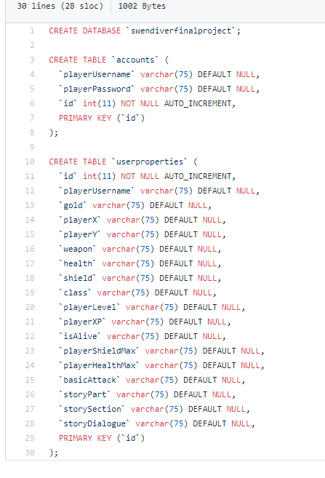
Technologies
For my project I used C#, MySQL (phpMyAdmin), and WPF in Visual Studio.

Slide 5
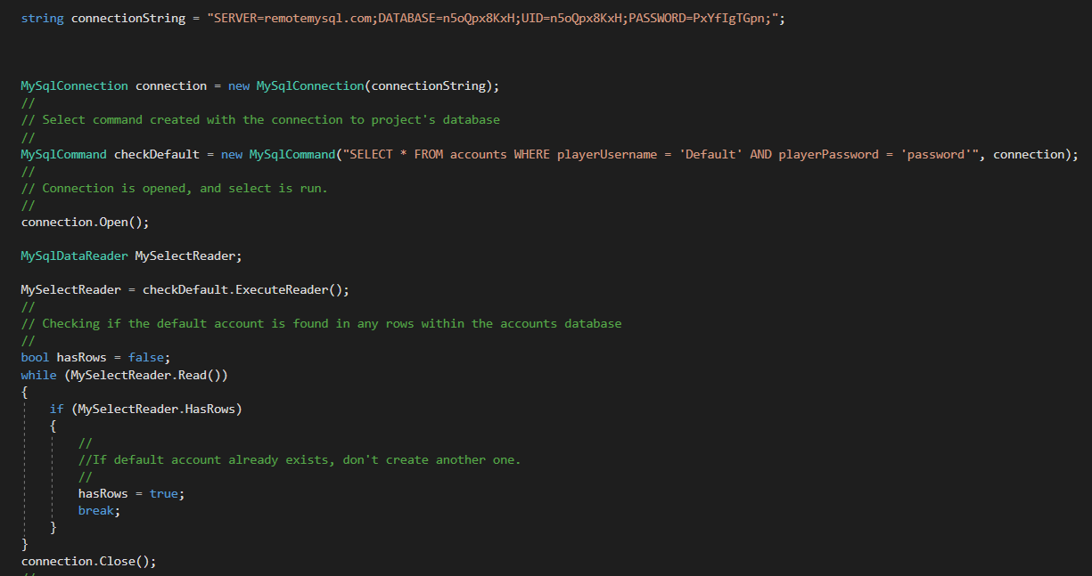

Slide 6
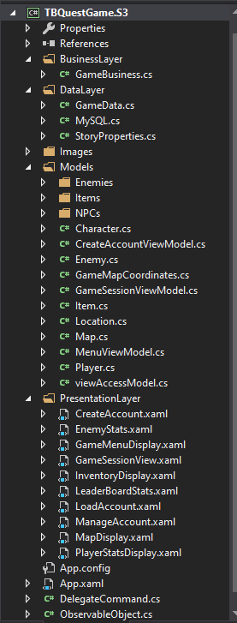
Design patterns used
I setup my project with the MVVM and 3-Tier patterns.
This allowed for better organization and easier tracking of data throughout the project.
Folders were used to organize related classes such as Items, NPCs, and Enemies.

Slide 7
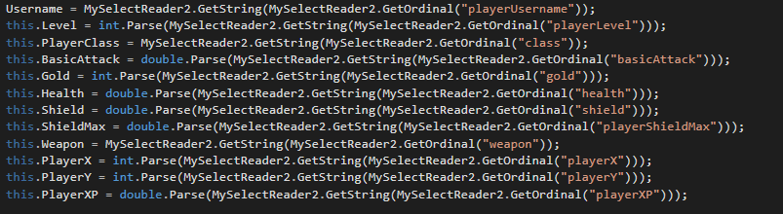
Problematic Code
One problematic part of the project would be the loading of the player’s class and XP. This was resolved after an hour of sifting through code and finding I had been trying to grab the values from the wrong variable.

Slide 8
Future versions of the application
Adding more weapons and items for the player to have fun with
More places within the map for the player to explore
Saving of the full inventory instead of just the player’s weapon

Slide 9
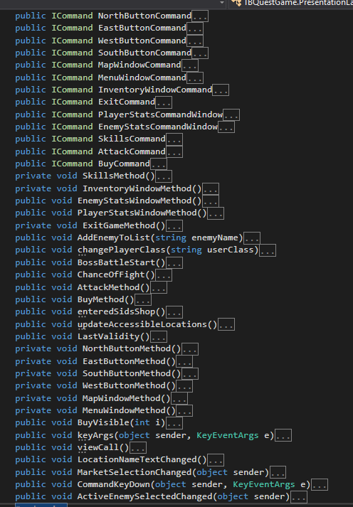
Personal Takeaways
Learned how to use MySQL in C# and use the data for application purposes.
Used ICommand so much it’s burned into my brain.

